Slide 1
Visualization of Landscape Changes using Synthesized Aerial Imagery
Felix Saaro
Semester Project
14. January 2025, Zürich
Notes:
Introduction
My name is Felix
I am a part time master student in data science at the ZHAW
I work 50% as a research assistant at the Centre for Artificial Intelligence also at the ZHAW
Now the reason that i am here at PLUS is that in my semester project I not only want to develope the technical aspects of this project but also leverage the expertise that you have here to create something useful.
I belive that this combination of domain expetise and technical know-how makes the project very interessting to me

Slide 2
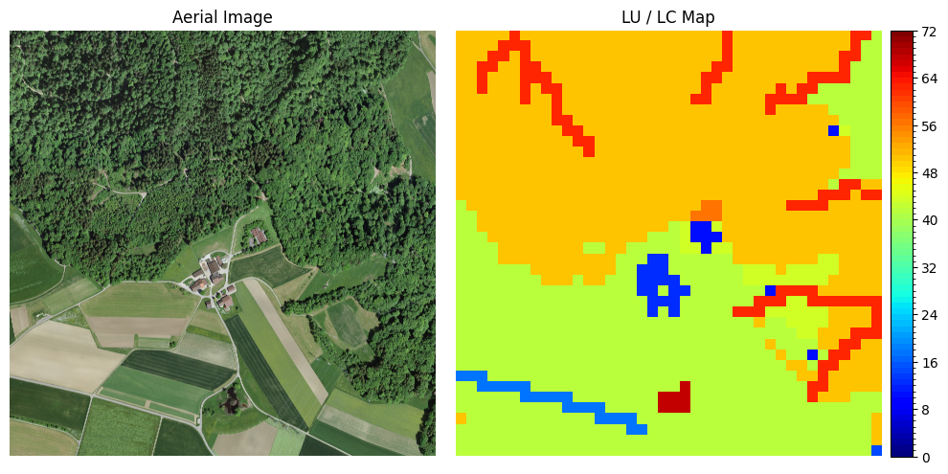
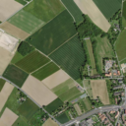
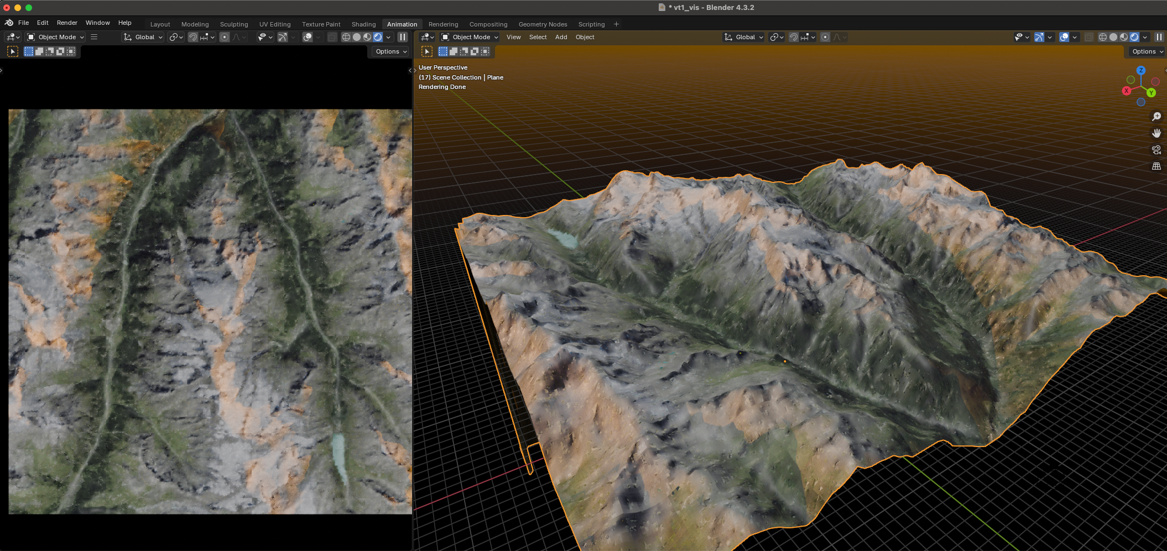

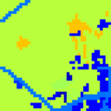
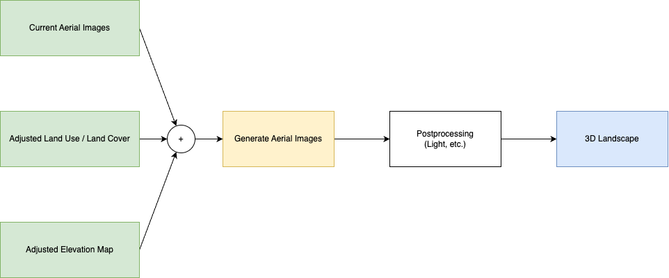
Recap
Idea
Train a generative model to syntehsizes aerial imagery based on land use and land cover maps
Notes:
Goal Visualize landscape changes without a lot of manual effort or technicall skills, i.e. Photoshop Blender. Such that a researcher having the domain knowledge can effortlessly produce visualizations. Idea
Train a generative model that syntehsizes aerial imagery based on land use/cover maps
As well as a Pipeline / Workflow to create 3d scence with it
Input / Output of the Final Product
Current Aerial IMagery
Future Land Use / Land Cover Maps
Output: Aerial Image
Datasources
SWISSIMAGE
SWISSALTI3D
Land Use Statistics (NOAS04)
Method
Use a diffusion based approach => Conditional UNET

Slide 3
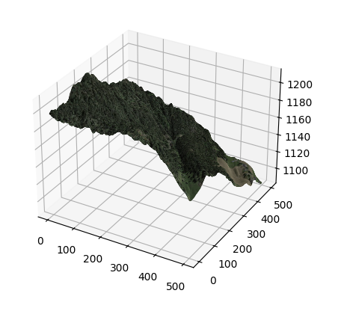
Data
SWISSIMAGE
2 m Resolution
Since 1946
Swiss Land Use Statistics (NOAS04)
25 m Resolution (Downscaled by Giuliani et. Al.)
Since 1972
17 Basic Categories
Combines Land use and Land Cover
Hand annotated, supported by ADELE Model
SWISSALTI3D
Elevation model without vegetation
0.5 m Resolution
G. Giuliani, D. Rodila, N. Külling, R. Maggini, and A. Lehmann, “Downscaling Switzerland Land Use/Land Cover Data Using Nearest Neighbors and an Expert System,” Land, vol. 11, no. 5, Art. no. 5, May 2022, doi: 10.3390/land11050615.
Notes:
To generate aerial images from land use / land cover maps requires a lot of data
The gerneation is based on three publicly available datasets
SwissImage provides the aerial images with a resoltuion of 0.1m
The Swiss Land Use Statistics provide a map in which the 100m grid intersections are assigned to one of 72 classes (4 main classes, 17 sub classes, 27 sub-sub classes and 72 base classes)
Elevation model is provided with a 0.5m resolution without vegetation

Slide 4
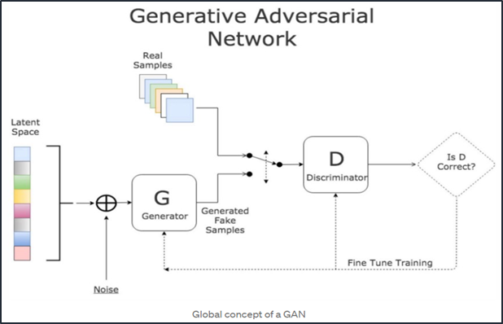
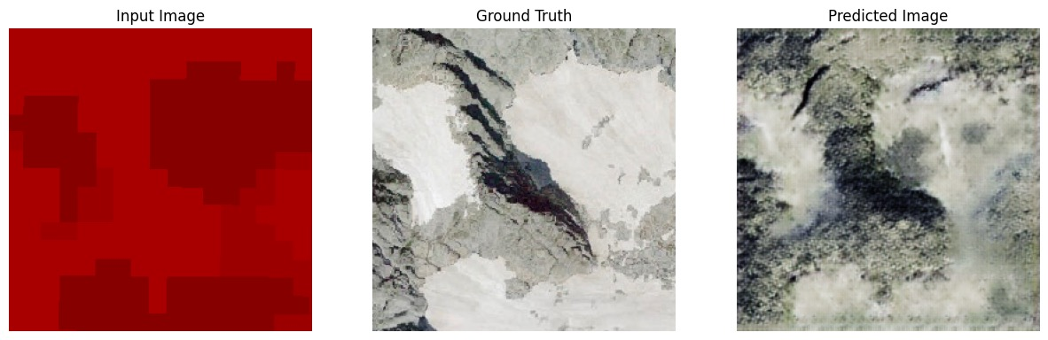
Base Method Generative Adversarial Networks
Image-to-Image Translation using a GAN
Pix2pix model
Trains a Generator and a Discriminator
Discriminator judges if the generated sample is passable
Generateor is an Encoder-Decoder Neural Network
Notes:
With all this we can start thinking about the generation
The first thing that came to my mind is using Generative adversarial networks
It is an established method that some might call outdated (2017)
It works by training two networks
One that generate images using an encoder-decoder NN
One that judges the generation to improve it
I tried training a pix2pix model and verified that this can work (overfitted, small sampel size)

Slide 5
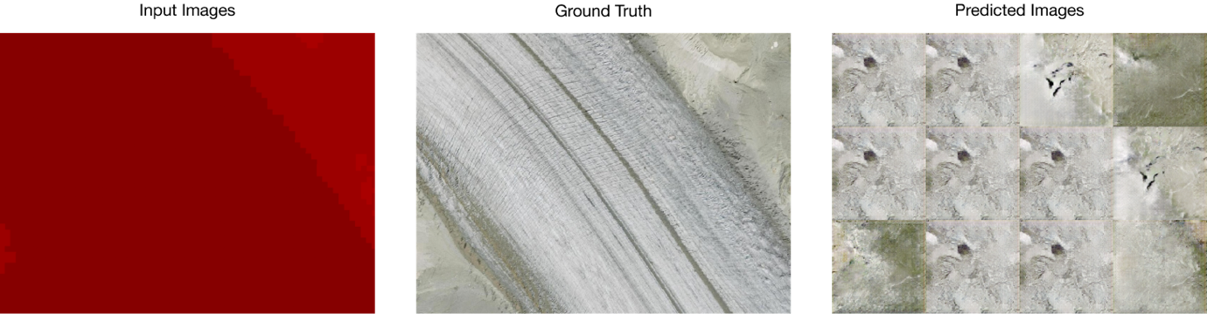
Base Method Generative Adversarial Networks
Tiles can only be generated independently
Without further processing or another generative model, the intersection between tiles are visible
Notes:
However the tiles that are generated are always independend of each other.
And this makes it very difficult to produce an image over a larger area.
Especially in this scenario where some tiles are entirely from 1 class.
The overfitted model is also not good at producing non deterministic results

Slide 6
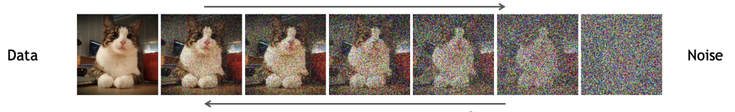
Proposed Method Conditional UNET
Start with a diffusion based method utilizing a U-Net architecture
Extend to a Conditional U-NET to incorporate segmentation
Two step mehod
Generate low resolution tiles over a larger area (e.g. 4 tiles)
Generate high resolution tiles using the low resolution tile
Utilzing a DDPM Framework
Notes:
I decided to start with a similar approach. Using a very basic diffusion method with a U-Net architecture to generate the images.
The only enhancement to this method that I will be doing from the start is the conditioning on the land use / land cover maps.
To overcome the tiling issue I want to improve the model to take a pre generate image as an input. This way I can first generate a low resoltuion tile of a larger area (2x2 tiles) and take that as an input to create the high resolution tiles.
The cool thing with diffusion is that we do not have to take noise as a starting point to generate the image. The low resolution image can already be used and then improved step by step.
Denoising Diffusion Probabilisitc Model
DDPM Adds the noise during training and the UNET predicts the added Noise.
During generation the extracts the features from the noisy image.

Slide 7
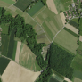

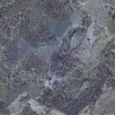
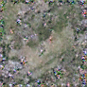
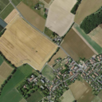

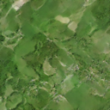
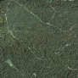
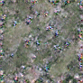
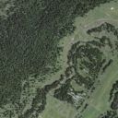

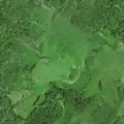
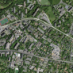
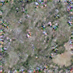
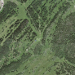

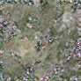
Results
Original
Segmented
Generated
Best results
> 80 Experiments
> 100 GPU Hours
Different Implementations
Scratch
Reference Implementation
Different Denoising Strategies
DDPM
DDIM
Hyperparameter Search
Class Selections
72 Classes
17 Classes
2 Classes (Forest, None)
Notes:
Conclusion
- The implementation of this method does not seem to be working
- Might be due to
Not suitable for this type of problem?
Lack of understanding?
- The reason why this method is appealing
Low number of training samples required (Compared to other methods)
Proven conditioning mechanism
- Conclusion
Method cannot be ruled out

Slide 8
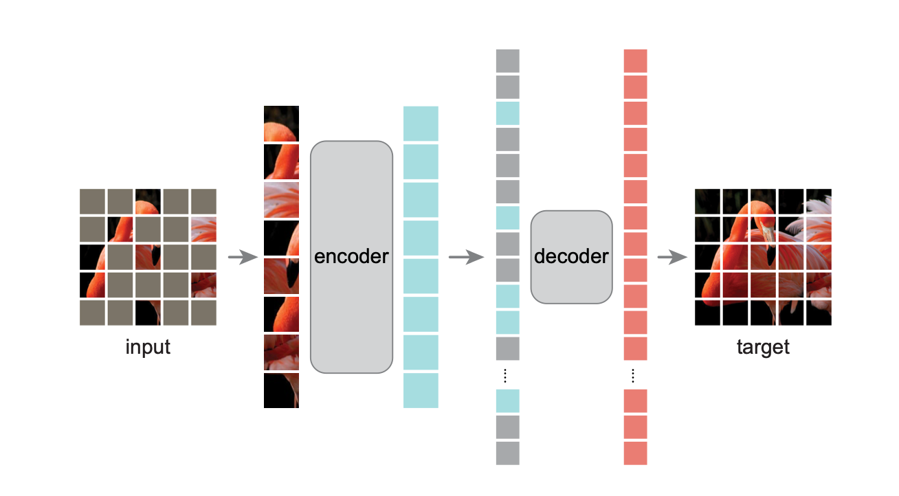
Alternative Method Masked Auto Encoder
Idea
Unsupervised reconstruction of masked images
Steps
Patchify Image
Add positional encoding
Mask portion of the patches (~75%)
Encode visible patches
Reconstruct using decoder
Benefits
Highly suitable for this task
Trained model can be fine tuned (Segmentation)
Drawbacks
Requires a lot of resources (Training Data, GPU & Memory)
Notes:
What are MAEs?
What are Vision Transformers?
How does the training of a ViTMAE look like?
Unsupervise
Pretraining / Fine Tuning
Problems with this Method
Requires a lot of data and compute resources
Used by me:
1x H100 GPU with 80GB of Memory (~120 GPU-Hours)
Used in comparable methods:
IBM & Nasa on Prithvi-EO-2.0 300M (80 GPUs, ~21’000 GPU-Hours)
IBM & Nasa on Prithvi-EO-2.0 600M (240 GPUs, ~58’000 GPU-Hours)

Slide 9
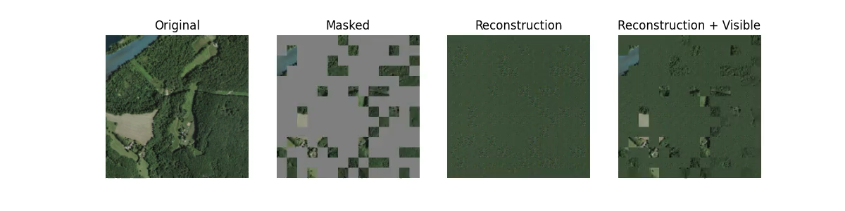
Alternative Method Masked Auto Encoder
Overfitted on 1 Sample
Prove that the model can learn something
Prove that the implementation works
1000 Epochs
Loss converges after 500 epochs

Slide 10
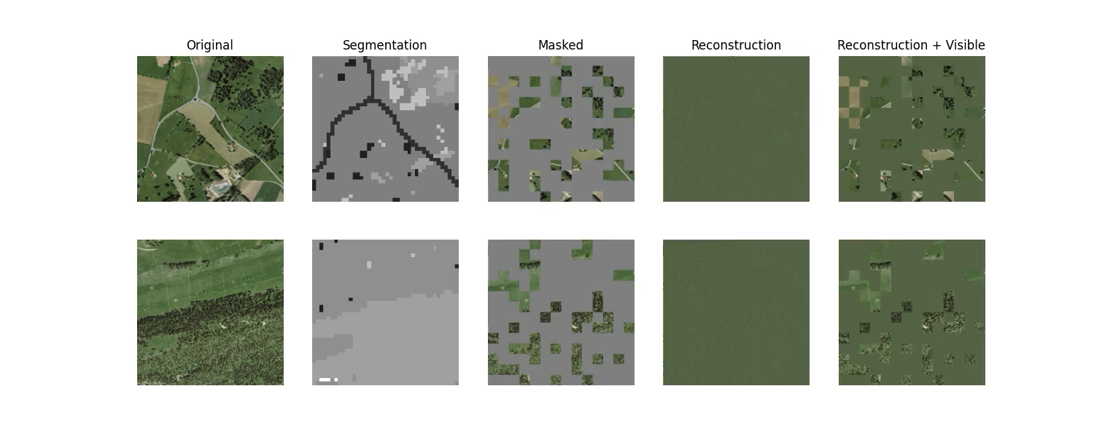
Alternative Method Masked Auto Encoder
Trained on small Sample (N=10)
10000 Epochs

Slide 11
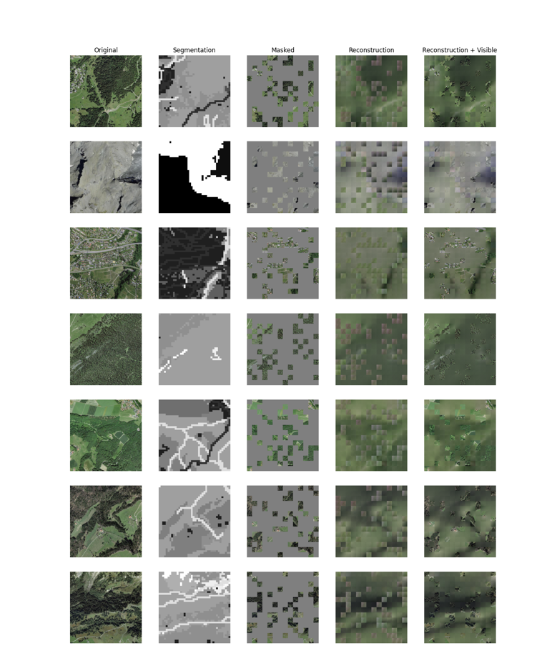
Results
Trained on 30’000 Samples
1000 Epochs
~120 GPU Hours

Slide 12
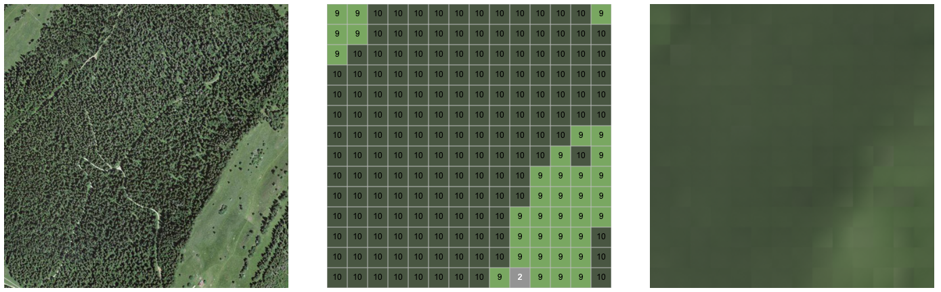
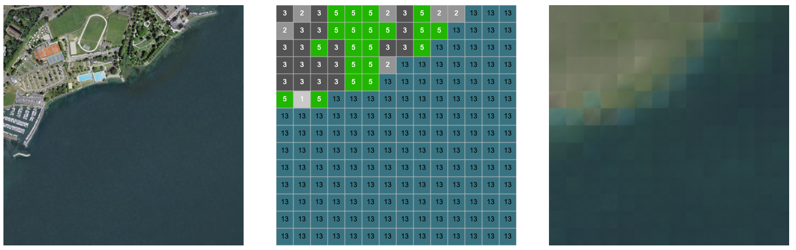
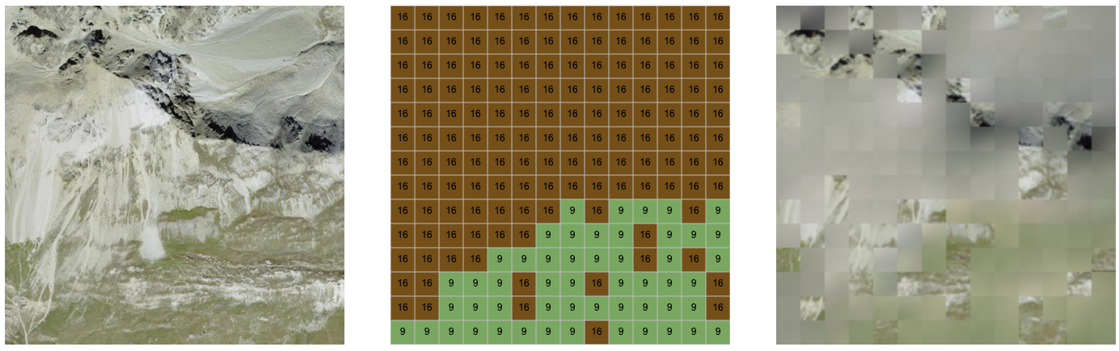
Results
Per Tile (1 km²)
Low resolution output
Indicating Decoder is not trained enough
Preserves Surrounding color and shadows

Slide 13
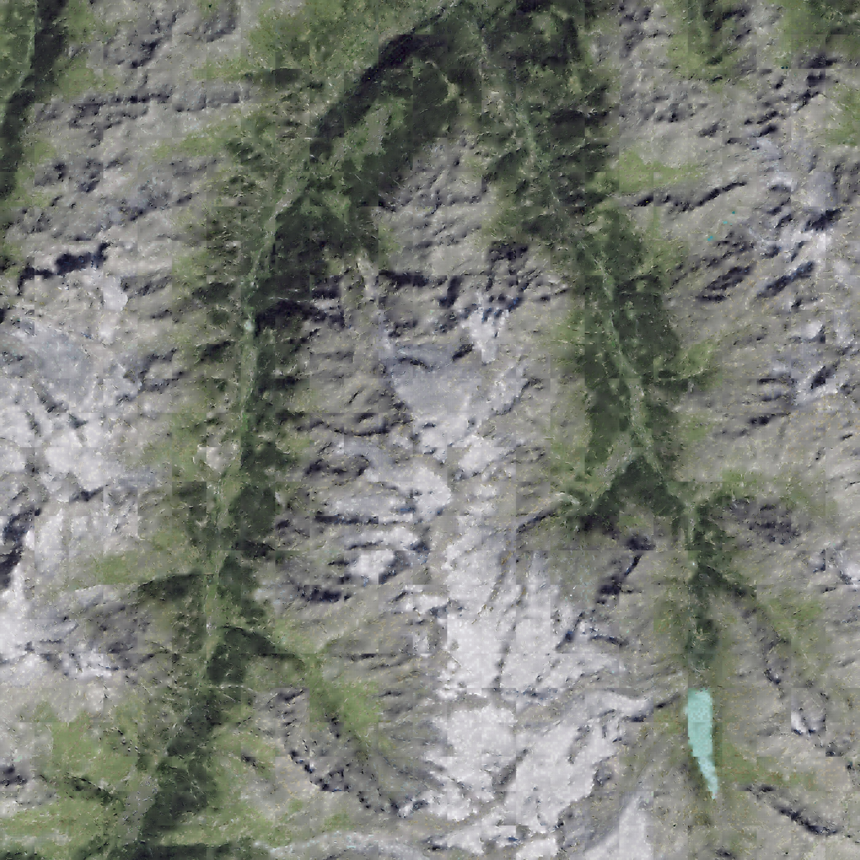
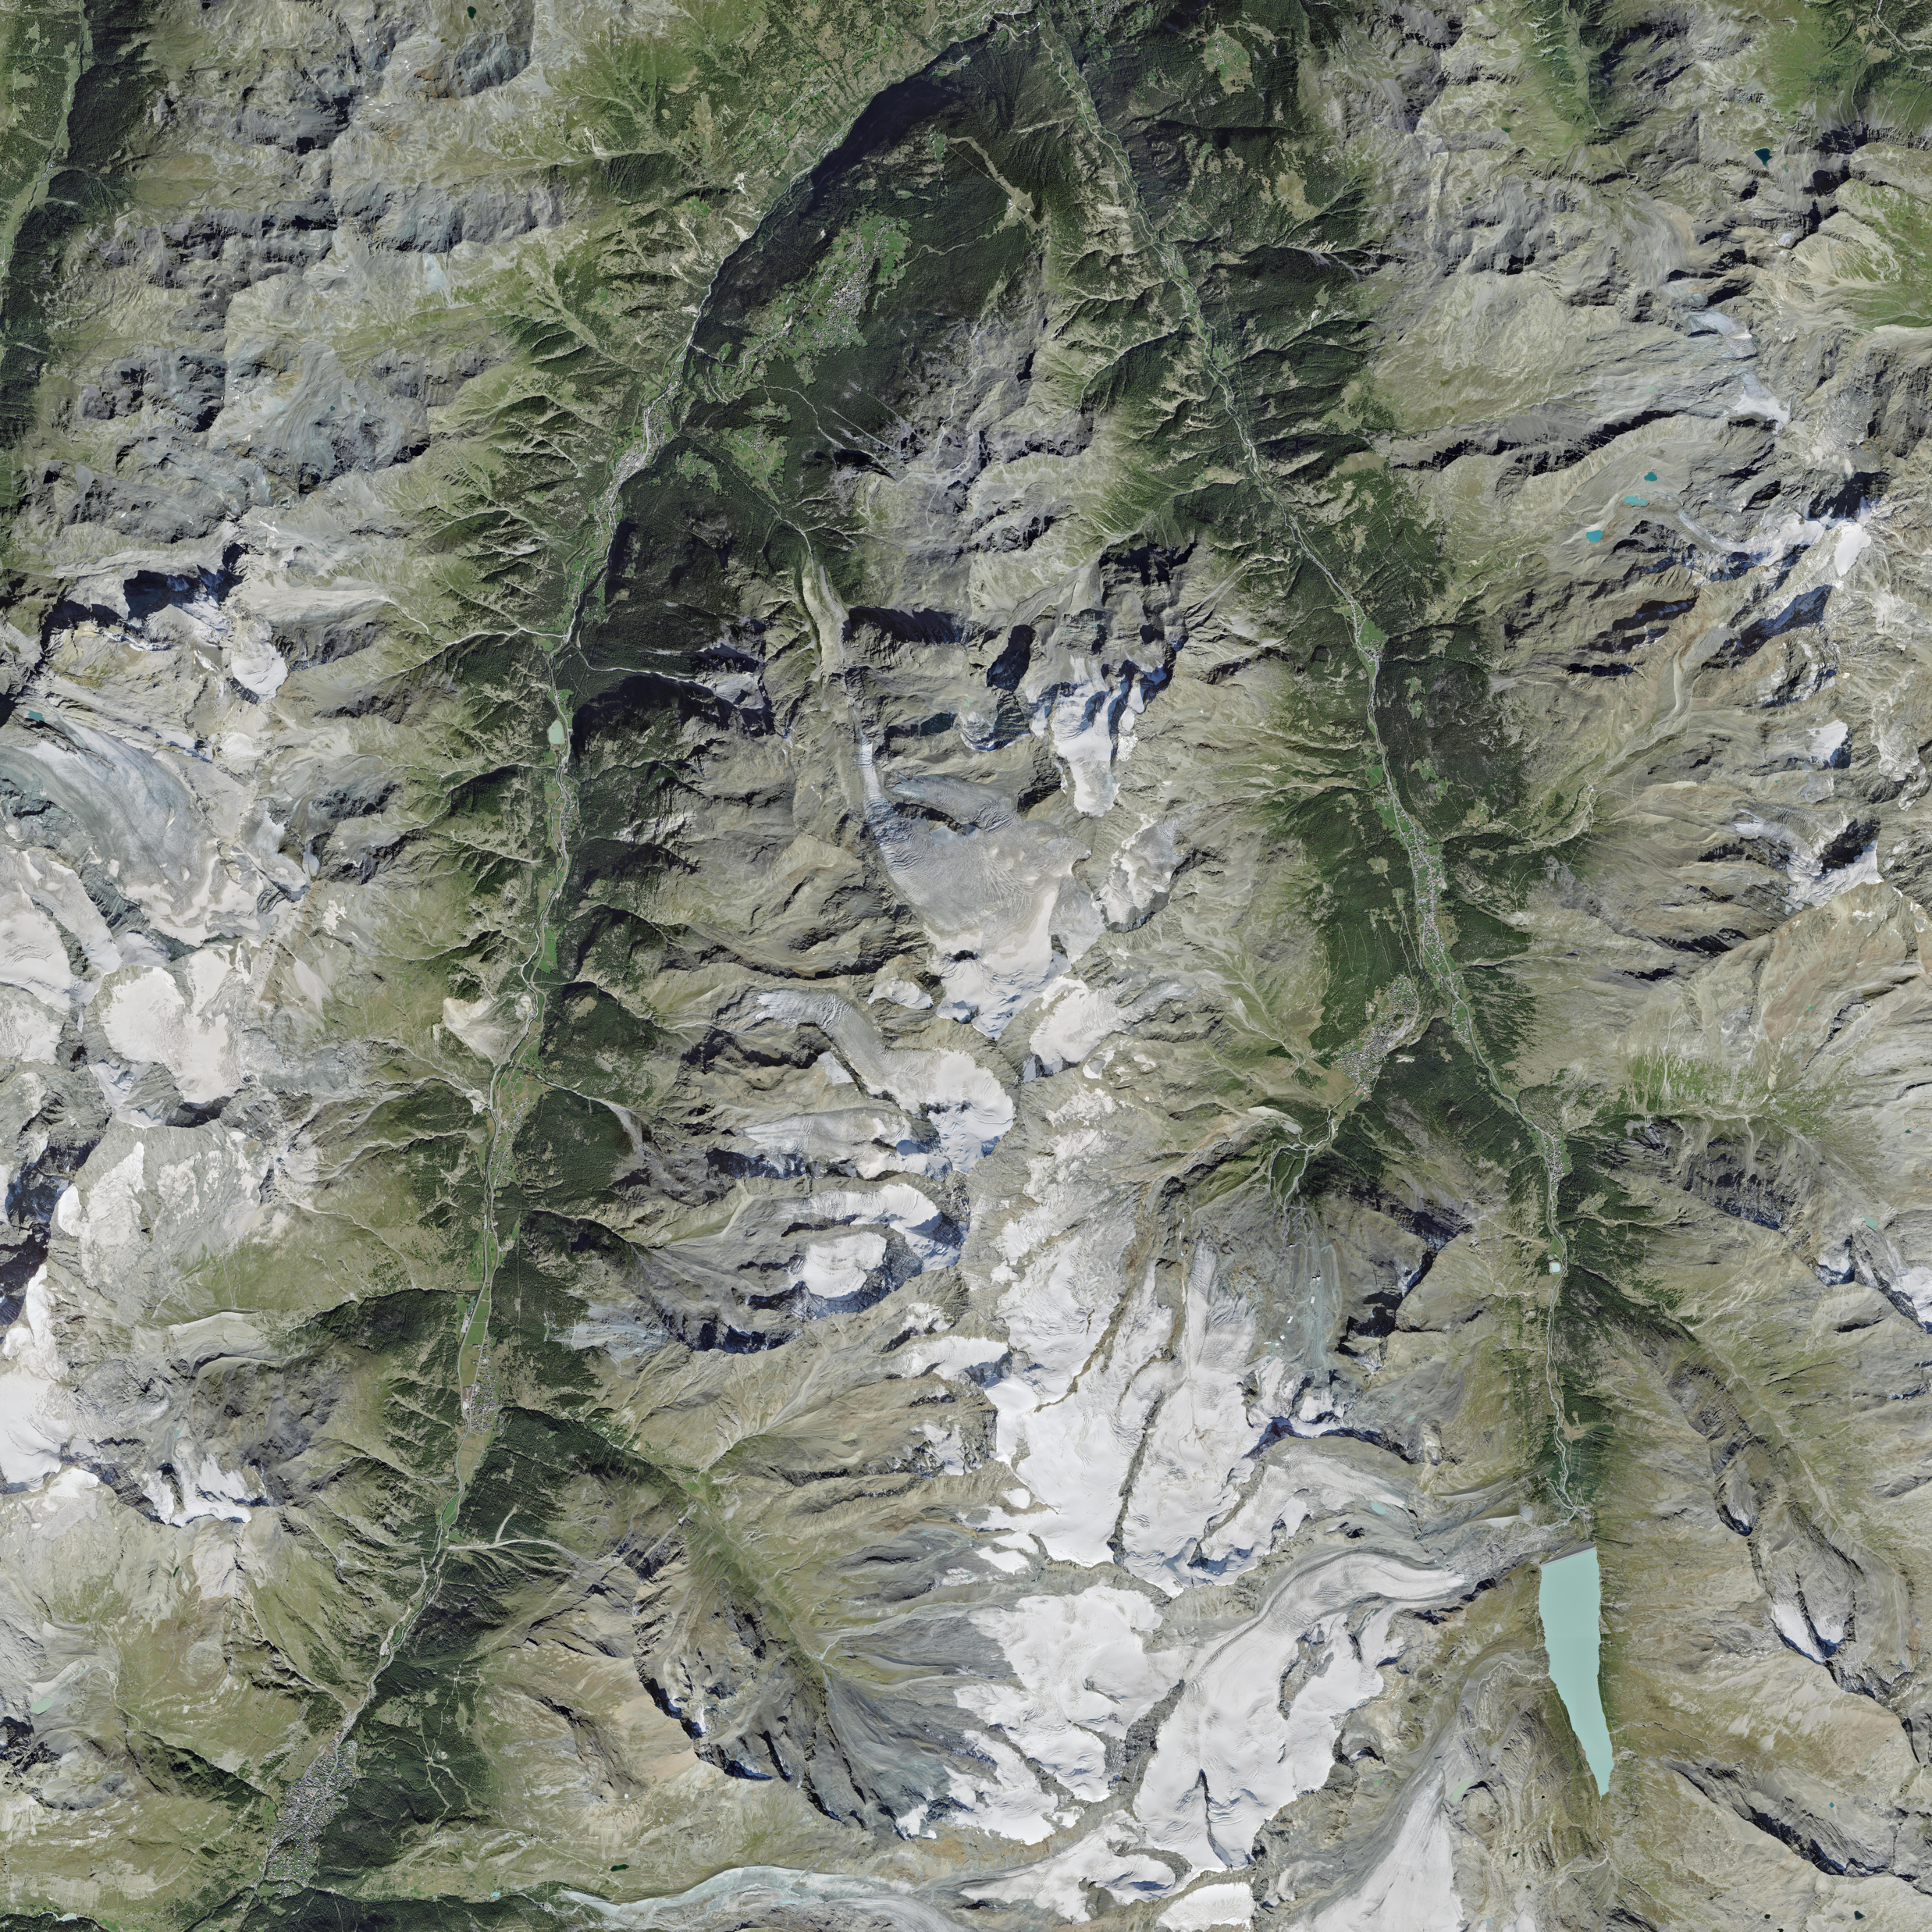
Results
Area (25 km²)
Low resolution matters less
Straight lines from the patches visible
Clear distinction between the land uses

Slide 14
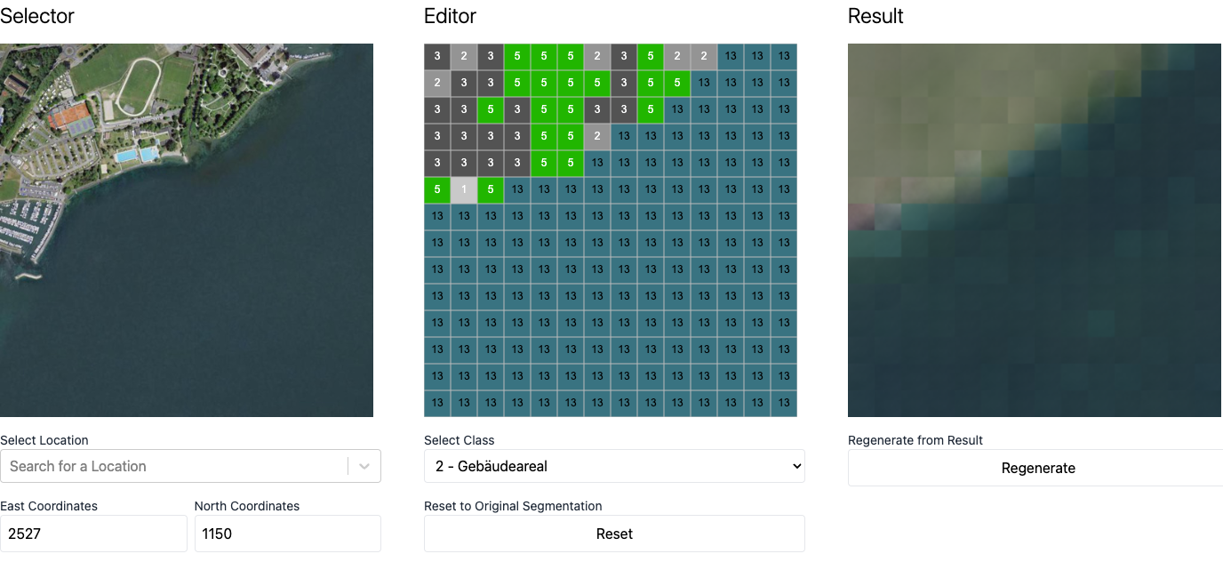
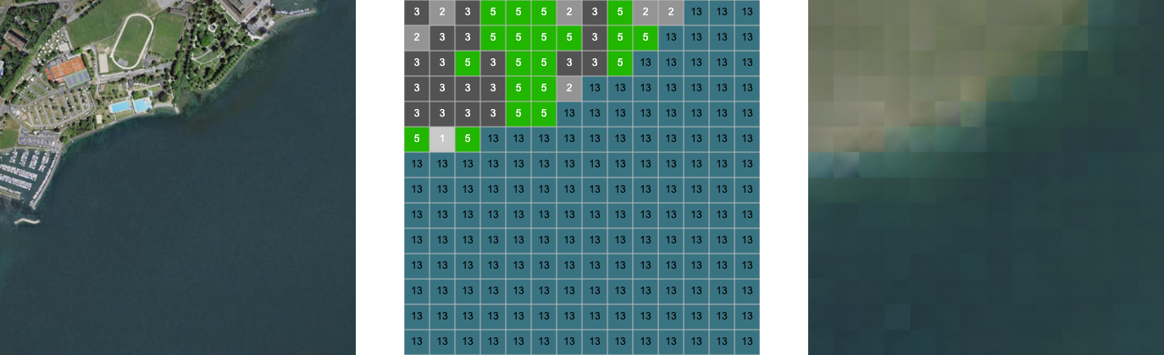
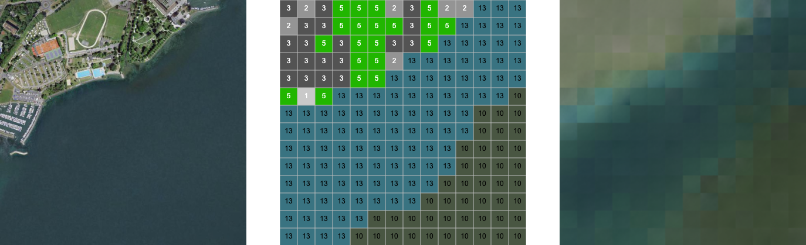
Results
Manipulating Land Use / Land Cover
Simple tool to draw classes and auto generate the images
Works for classes that are represented well in the training set
Notes:
Forest Problem => How can we preserve the locality context?
Forest does not look the same everywhere
Different Time of Year
Different ecological zone (difference North, South)
Lakes show different colors (Alpine Lake vs Lac )

Slide 15
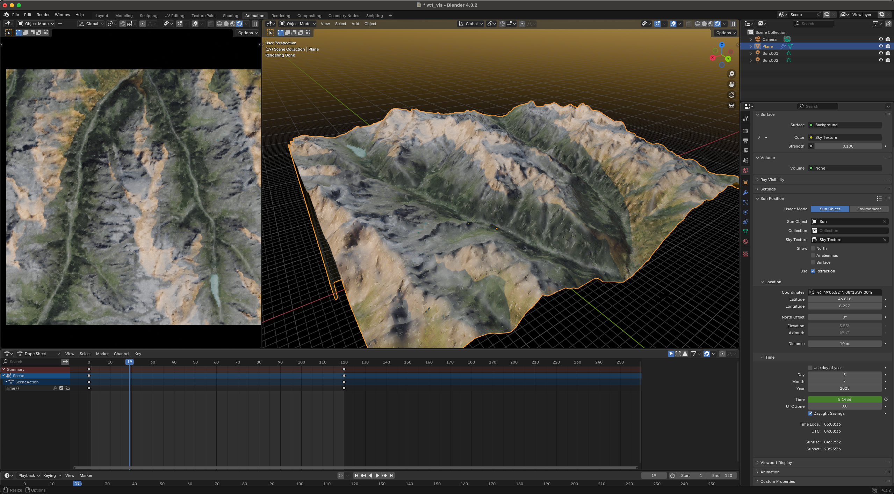
Results
Postprocess
Apply Smoothing
Apply Elevation Map
Add Sun based on Location and Date
Notes:
Despite the low output resoltuion we can use the generated tiles
Focus on areas with few structures
Show the Pipeline
Built a tool to manipulate the land use / land cover
Show the generation based on the new segmentation
Import into Blender
New Images
New Alti Map => Separate tool to adjust the elvation
Adjust lighting
Render => Show samples
Different Regions
Mountains
Lake

Slide 16
Conclusion
Results resemble the original images but have low resolution
Conditioning on land use / land cover works
To be usable it requires more training data and resources
Method is easily scalable!
Next steps
Use higher Resolution Images (0.5m Res)
Cut Images into smaller tiles (256x256)
64 Mio Tiles for Training (1600x Size)
Notes:
(0.5m Resolution) => 42’689 Files, 10’000x10’000 Resoltuion
For the current results I used 120 GPU Hours
Multiplied by 1600 for the increase in training
120 * 1600 = 192’000 GPU Hours
Optimizations:
Lower Epoch Number
Larger Batch Size
Estimate is about 21’000 GPU Hours => Comparable model by IBM and NASA

Slide 17
Questions & Discussion

